Slide 1

SDP
Rating and charging prepaid system
GFI Informática
Knowledge Transfer

Slide 2
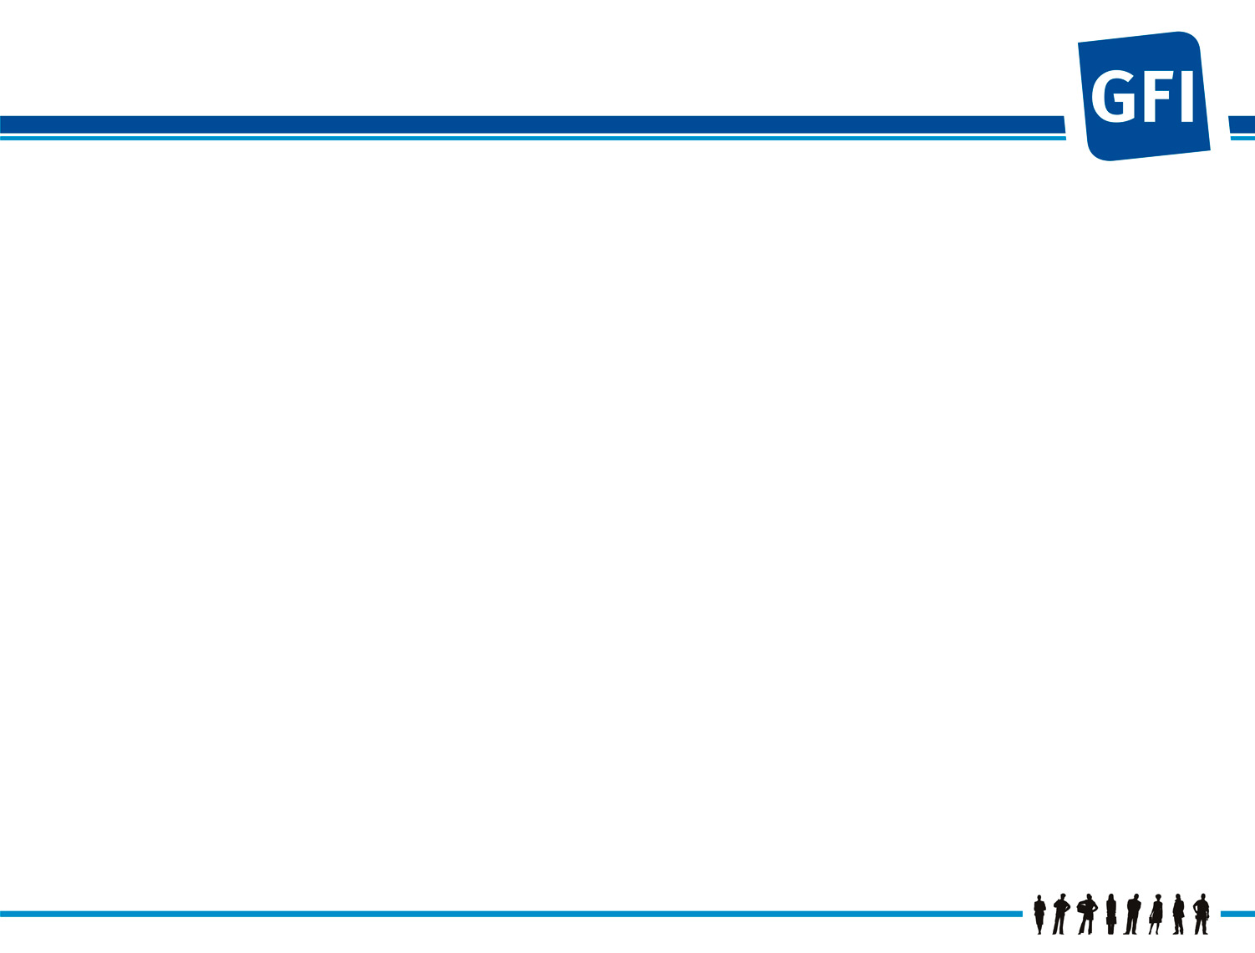

Sumary
Sumary
  Introduction
  Functions
  Map Provision
  Charging Map
  GUI SDP’s
  NCR’s

Slide 3

Introduction
System made by Ericsson for PrePaid (PPS)
  PPS has two nodes:
    SCP (Vodafone)
    SDP (IBM)
    There are 6 machines in SDP node
      5 machines are in production environment (SDP141, SDP143, SDP145, SDP341 and SDP541)
      Only one is in testing environment as backup to the other machines.
PPS
SCP
SCF
SDP
MSC
Conmutación

Slide 4
Introduction
SDP only charges Voice and Video Calls
Currently there are 43 Service Class (SC) defined
And 17 tariff structures (TID = Tariff ID).
SDP IS NOT master; master is CUR system.
It’s HOT BILLING

Slide 5
Sumary
Sumary
  Introduction
  Functions
  Map Provision
  Charging Map
  GUI SDP’s
  NCR’s

Slide 6
Functions
SDP
  Clients database
  Service Class definition
  Tariff structures definition
  Management Cards
    Substract
    Adjust
    Recharge
SCP
  Call discriminator
  Add prefixes to the types of use for rates call
  Consulting SURAS/IN system for certain products

Slide 7
Sumary
Sumary
  Introduction
  Functions
  Map Provision
  Charging Map
  GUI SDP’s
  NCR’s

Slide 8
Map Provision
¿se puede aprovisionar?
CUR
Cobro Provisión
Cobro Provisión
CORAL
SDP
Canales de
Provisión
BUS TIBCO
Actualización datos
CUR
Actualización datos
SDP

Slide 9
Sumary
Sumary
  Introduction
  Functions
  Map Provision
  Charging Map
  GUI SDP’s
  NCR’s

Slide 10
Charging Map
SURAS
CUR
PPS
SCP
SCF
SDP
MSC
CDRs-voz
Conmutación
CS1+
INAP CS1+
Mediación
CS1
PUC
COBROS DESDE
OTROS SISTEMAS
CORAL
HLR
CS1
RPC
DATA
WARE
HOUSE
LOGAN2
Bonos Voz/VT
SIRA
(Recargas)

Slide 11
Sumary
Sumary
  Introduction
  Functions
  Map Provision
  Charging Map
  GUI SDP’s
  NCR’s

Slide 12
GUI
Service Class and database definition
Tariff Structures definition
Rating Tariff Simulator

Slide 13
Sumary
Sumary
  Introduction
  Functions
  Map Provision
  Charging Map
  GUI SDP’s
  NCR’s

